Slide 1
Data Visualization with Tableau – Level 1
QCL Workshop Series
#Data #Visualization and #Tableau
Instructors: Jeho Park and Zeyad Kelani

Slide 2
Make sure you are signed-in
http://bit.ly/s2020-tableau-RDSP-L1

Slide 3
Agenda
What is Tableau
Tableau Desktop Workspace
Tableau Data Connections
Filtering Data
Sorting, creating groups, hierarchies and sets
Charts and graphs

Slide 4
After this workshop, you will be able to…
Understand fundamentals of data visualization
Connect various data sources to Tableau
Create different worksheets to visualize various insights of your data
Create Tableau Dashboard showing meaningful data visualization
Share Tableau Dashboard on Tableau Public/Online

Slide 5
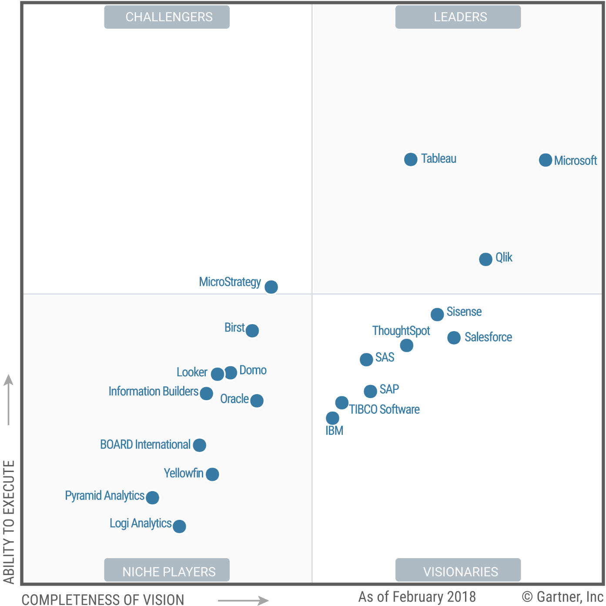
What is Tableau?
Magic Quadrant for Analytics and Business Intelligence Platforms
Tableau is one of the fastest evolving business intelligence and data visualization tools.
Tableau software was founded in 2003
Source: Gartner (February 2018)

Slide 6
Cycle of Visual Analytics

Slide 7
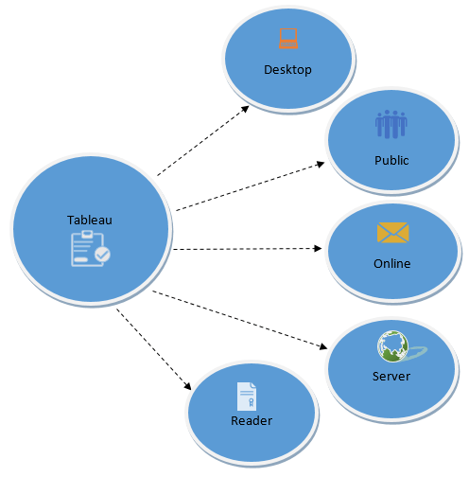
Tableau Product Suite
Tableau Desktop
Tableau Public
Tableau Online
Tableau Server
Tableau Reader
Source: guru99.com

Slide 8
Data Analytics in Tableau
Developer Tools: The Tableau tools that are used for development such as the creation of dashboards, charts, report generation, visualization fall into this category. The Tableau products, under this category, are the Tableau Desktop and the Tableau Public.
Sharing Tools: As the name suggests, the purpose of the tool is sharing the visualizations, reports, dashboards that were created using the developer tools. Products that fall into this category are Tableau Online, Server, and Reader.

Slide 10
What can you do with Tableau?
https://public.tableau.com/en-us/s/gallery/analyzing-ums?gallery=votd

Slide 11
Installing Tableau
Install the free trial of Tableau here:
https://www.tableau.com/products/trial
To continue using Tableau after the trial students and instructors can apply for a free license here:
https://www.tableau.com/academic
Notes:
Add how to get student/instructor license

Slide 12
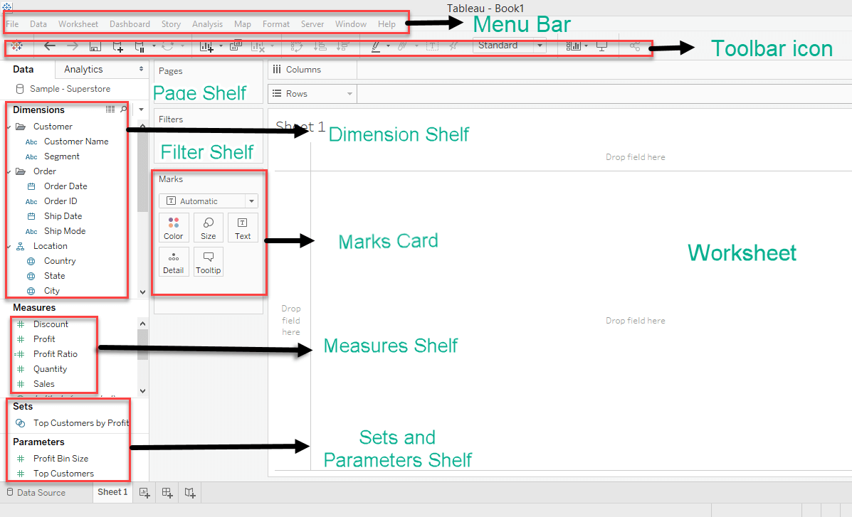
Tableau Desktop Workspace

Slide 13
Tableau Desktop Workspace Cont’d
Menu Bar: It consists of menu options such as File, Data, Worksheet, Dashboard, Story, Analysis, Map, Format, Server, and Windows. The options in the menu bar include features such as file saving, data source connection, file export, table calculation options, and design features for creating a worksheet, dashboard, and storyboard.
Toolbar Icon: Toolbar icon present below the menu bar can be used to edit the workbook using different features such as undo, redo, save, new data source, slideshow and so on.
Dimension Shelf: The dimensions present in the data source can be viewed in the dimension shelf.
Measure Shelf: The measures present in the data source can be viewed on the measure shelf.
Sets and Parameters Shelf: The user-defined sets and parameters can be viewed in the sets and parameter shelf. It can also be used to edit the existing sets and parameters.
Page Shelf: Page shelf can be used to view the visualization in video format by keeping the relevant filter on the page shelf.
Filter Shelf: The filters that can control the visualization can be placed on the filter shelf, and the required dimensions or measures can be filtered in.
Marks Card: Marks card can be used to design the visualization. The data components of the visualization such as color, size, shape, path, label, and tooltip used in the visualizations can be modified in the marks card.
Worksheet: The worksheet is the place where the actual visualization can be viewed in the workbook. The design and functionalities of the visual can be viewed in the worksheet.

Slide 14
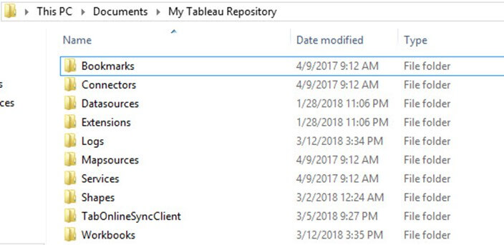
Tableau Repository:
Tableau repository is used to store all the files related to tableau desktop. It includes various folders such as Bookmarks, Connectors, Datasources, Extensions, Logs, Mapsources, Services, Shapes, TabOnlineSyncClient and Workbooks. My Tableau repository is usually located in the file path C:\Users\User\Documents\My Tableau Repository (windows version)

Slide 15
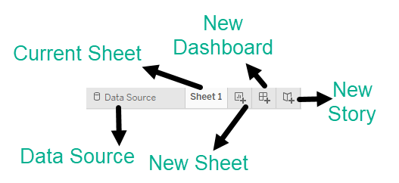
Tableau Navigation
Current Sheet:
Current Sheet can be viewed with the name of the sheet. All the sheets, dashboards and story board present in the workbook can be viewed here.
New Sheet:
The new sheet icon present in the tab can be used to create a new worksheet in the Tableau Workbook.
New Dashboard:
The new dashboard icon present in the tab can be used to create a new dashboard in the Tableau Workbook.
New Storyboard:
The new storyboard icon present in the tab can be used to create new storyboard in the Tableau Workbook.

Slide 16
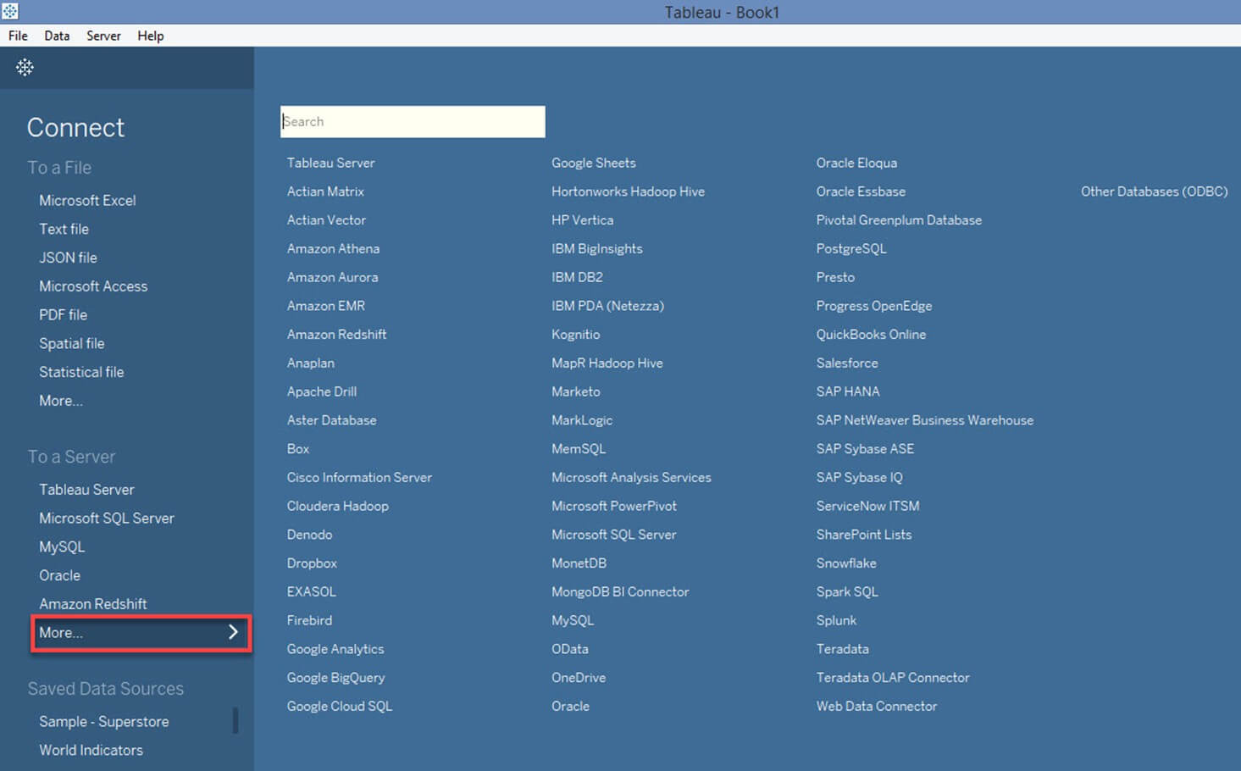
Tableau Data Connections

Slide 17
Data Repo
http://bit.ly/qcl-tableau-Level1-data

Slide 18
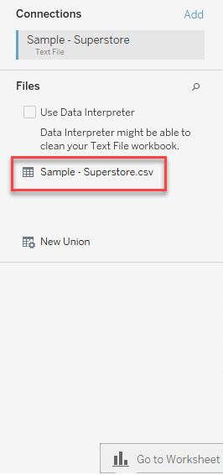
Let’s Connect to a text file
1- Click on the "Text File" option given in the data tab.
2- Select the ”SuperStore.csv” from your designated directory (C:\Users\User\Downloads\ Sample – Superstore.csv)
3- Click on "Open" Option. This will connect the text file into Tableau.
4- In the left pane, you will see the csv file (as in figure to the left)

Slide 19
Data Relationship
A relational Database/Excel file consists of multiple Tables/sheets. These multiple tables/sheets can be connected to each other in Tableau. This connection is established by 'Join' or 'Union' feature present in Tableau. The relationship between data in two or more tables needs to be specified while joining tables.
Joins:
Tableau can "join" tables. It can join up to 32 tables in a data source. While joining, the relationship between two or more tables can be specified. The tables present in the data source can be related to each other using the joins such as inner join, left join, right join and outer join. The functionalities of Join types are explained in the table below,
Inner Join | Left Join | Right Join | Outer Join
It joins all the common records between two tables or sheets. The joining condition can be given based on the primary key. One or more joining conditions can be specified to join the tables. Many tables can be joined together in Tableau for visualization. | A left join is used to join all the records from a left table and common records from the right table. One or more join conditions can be specified to left join two different tables. | A right join is used to join all the records from a right table and common records from left table. Based on the requirements, one or more joining condition can be set. | An Outer join is used to join all the records from both left and right table. Joining conditions can be set to join common records.

Slide 20
Download the datasets from

Slide 21
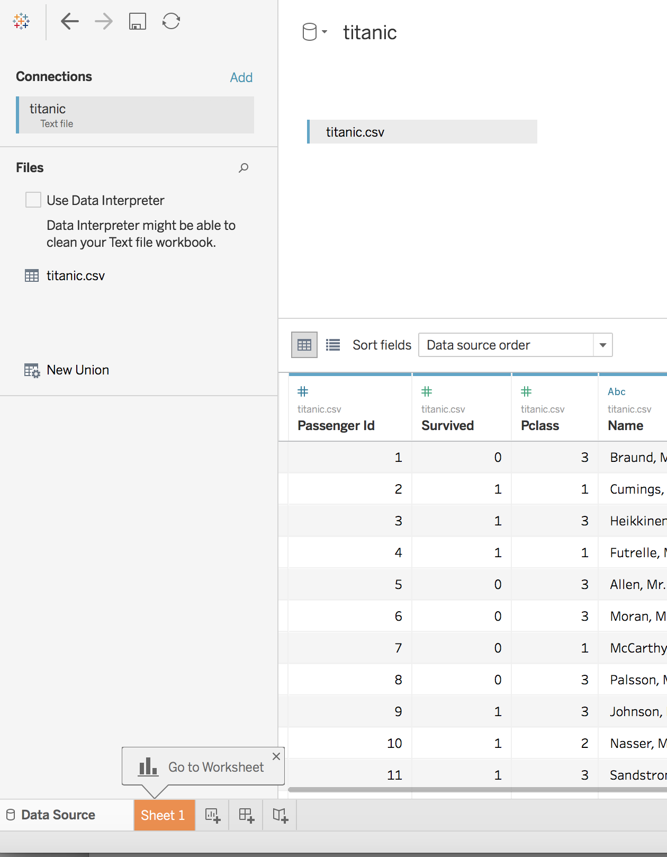
Connecting to Data
Tableau can connect to many filetypes
Excel, csv, spatial, statistical
Connect to Data > More… > titanic.csv
This is only a section of the full titanic dataset.
Source: https://www.kaggle.com/c/titanic/data
Different ways to connect your data:
E.g. Box.com integration (demo)

Slide 22
Connecting to Data
Variable | Definition | Key
survived | Survival | 0 = No, 1 = Yes
pclass | Ticket class | 1 = 1st, 2 = 2nd, 3 = 3rd
sex | Sex
Age | Age in years
sibsp | # of siblings / spouses aboard the Titanic
parch | # of parents / children aboard the Titanic
ticket | Ticket number
fare | Passenger fare
cabin | Cabin number
Tableau can connect to many filetypes
Excel, csv, spatial, statistical
Connect to Data > More… > titanic.csv
This is only a section of the full titanic dataset.
Source: https://www.kaggle.com/c/titanic/data
Different ways to connect your data:
E.g. Box.com integration (demo)

Slide 23
Tableau Environment >> Data types, Workbooks, Sheets, and interface

Slide 24
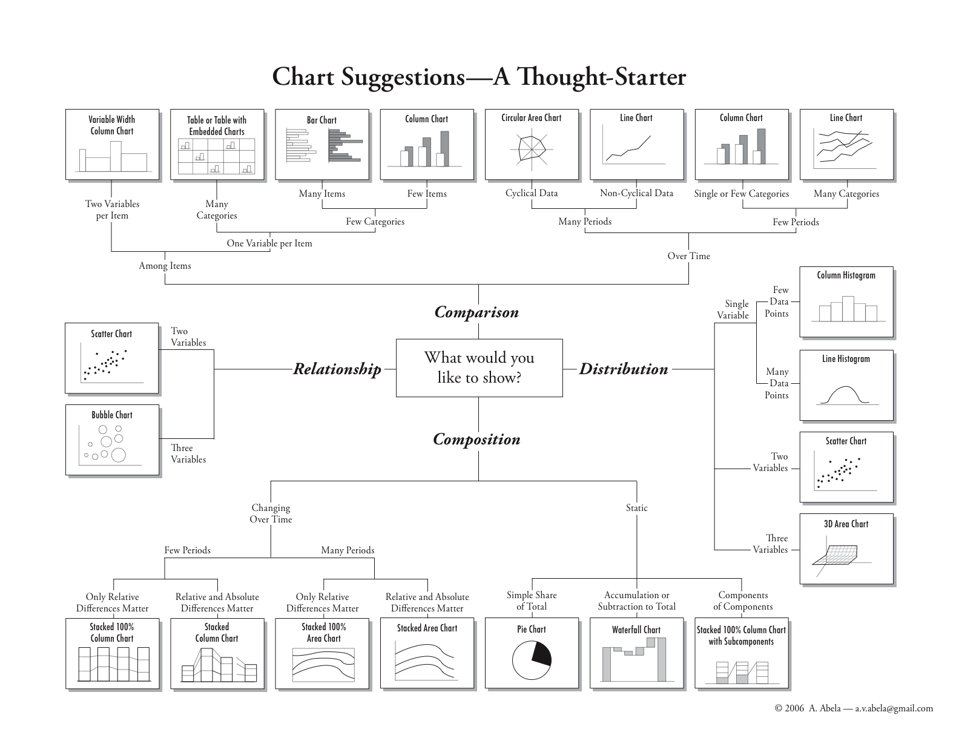
Chart Suggestions

Slide 25
Dimensions and Measures
Tableau assigns any fields to Dimensions if they cannot be aggregated. (e.g. categorical data in strings or Booleans)
Tableau assigns any fields to Measures if they can be measured, aggregated, or used for mathematical operations. (e.g., numbers)
Ordinal data is a categorical, statistical data type where the variables have ordered categories like school grades (1st year for 1, 2nd year for 2, etc.). Tableau will import these as measures but often they make more sense as dimensions.
[Action] Convert Pclass and Survived to dimensions

Slide 26
Questions
Tableau distinguishes data (fields) into two kinds. What are they?
Say, in your data set, one field contains zip code. Would the zip code field be dimension or measure?

Slide 27
Workbooks and Sheets
Tableau uses a workbook and sheet file structure, much like Microsoft Excel. A workbook contains sheets in three different kinds:
A worksheet contains a single view along with shelves, cards, legends, and the Data pane.
A dashboard is a collection of views from multiple worksheets.
A story contains a sequence of worksheets or dashboards that work together to convey information.

Slide 28
Workbooks and Sheets (cont.)
The difference between a workbook (.twb) and packaged workbook (.twbx) is that a packaged workbook is meant for sharing and includes the data source and any other files used to make the workbook.
Sharing Tableau workbook
Via Tableau file
Via Tableau Server
Via Tableau Public

Slide 29
Action
Check if you can login to Tableau Public (if you don’t have an account, you may want to create one now.)

Slide 30
Visualizing Data

Slide 31
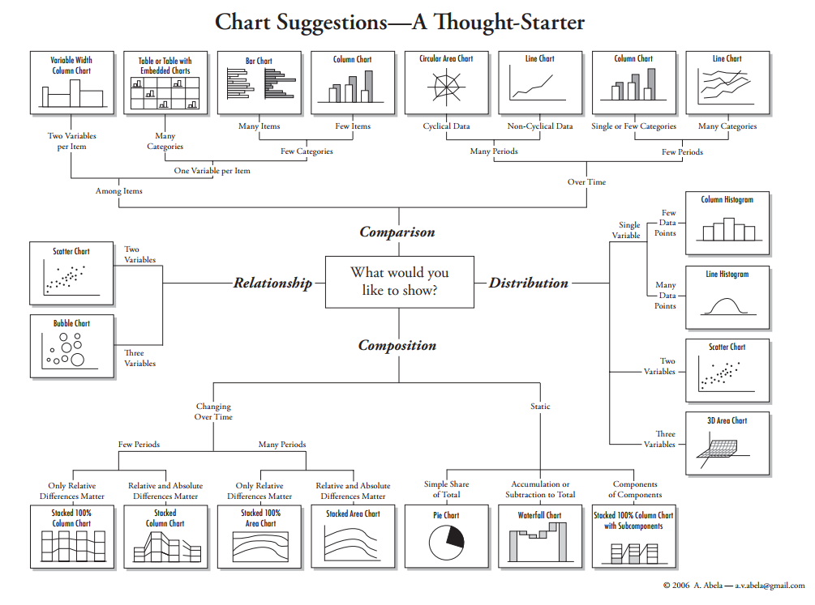

Slide 32
What do you want to show with your data?
Time Series
Ranking
Part-To-Whole
Deviation
Distribution
Correlation
Comparison

Slide 33
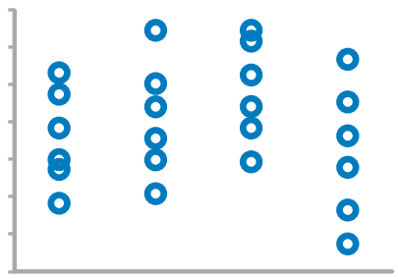
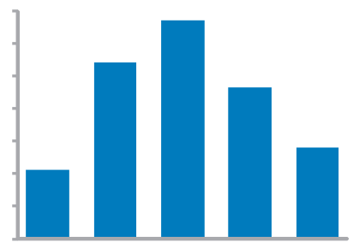
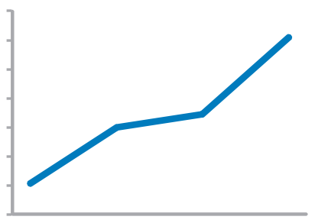
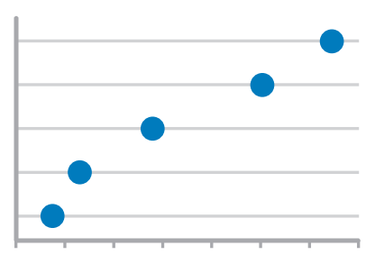
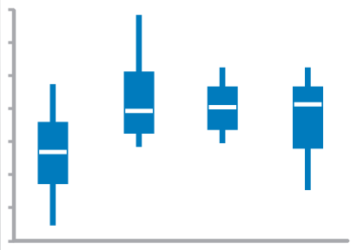
Time series values display how something changed over time
Strip Plot (multiple)
Only when also featuring distributions
Bar Graph (vertical)
To feature individual values and support their comparisons. Quantitative scale must begin at zero.
Line Graph
To feature overall trends and patterns and support their comparisons
Dot Plot (vertical)
When you do not have a value for every interval of time
Box Plot (vertical)

Slide 34
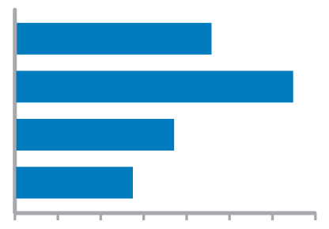
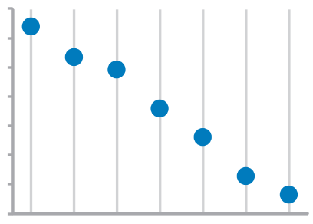
ranking values are ordered by size (descending or ascending)
Bar Graphs
Quantitative scale must begin at zero
Dot Plots

Slide 35
Part-to-whole values represent parts (ratios) of a whole
Bar Graphs
Quantitative scale must begin at zero

Slide 36
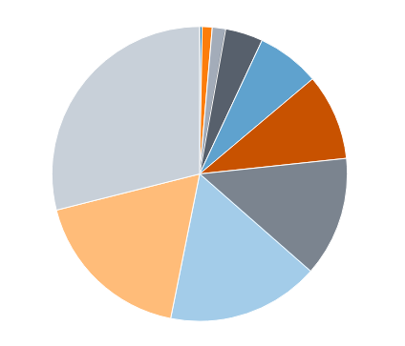
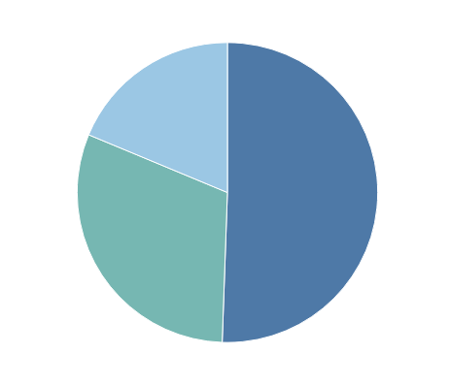
What about pie charts?
Commonly used to show parts of a whole
However…
Hard to judge relative size of pie slices – better at differentiating length
Take up a lot of space to present little information
Require labels and good color contrast to even be usable (often difficult)
Best use is when one overwhelmingly larger value than the rest – no need to focus on actual values

Slide 37
deviation difference between two sets of values
Bar Graphs
Quantitative scale must being at zero
Line Graph
Only when also featuring time series or single distribution

Slide 38

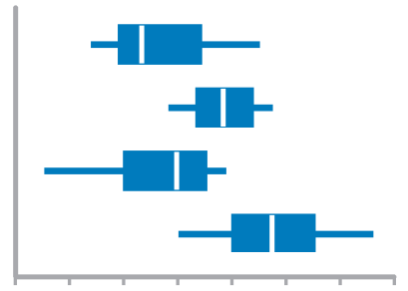
Distribution count of values per interval along quantitative scale
Strip Plot (single)
When you want to see each value
Bar Graphs
Quantitative Scale, must begin at zero
Strip Plot (multiple)
When comparing multiple distributions AND you want to see each value
Line Graph
To feature overall shape of distribution
Box Plots
When Comparing Multiple Distributions

Slide 39
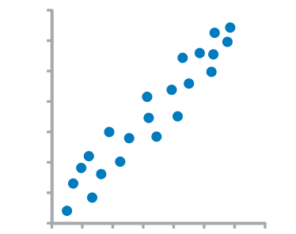
Correlation Comparison of two paired sets of values to determine if there is a relationship between them
Scatter Plot

Slide 40
Normal comparison simple comparison of values for a set of ordered items
Bar Graphs
Quantitative scale must begin at zero
Dot Plots

Slide 41
Visualizing Numerical Data
Tableau has a collection of charts you can use to visualize numerical data.
These include histograms, scatterplots, box-and-whisker plots, and bullet graphs.

Slide 42
Action and Question
You wonder how the age distribution of the Titanic passengers was like.
Show the age distribution of the passengers in a worksheet
In what age range were most Titanic passengers? Use groups of 10 years (e.g., 0-9, 10-19, 20-29, etc.)

Slide 43
Histogram
A histogram helps represent the distribution of numerical data.
It is similar to a bar chart but it is used to plot frequency of a continuous variable that is divided into bins.
[Action] Drag Age into Columns and then click on the histogram in the Show Me tab.
In what age range were most Titanic passengers?
NOTE: You can change the bin size by going to the Age (bins) dimension and clicking Edit...

Slide 44
Action and Question
Your colleague says that the older the passenger, the richer he/she would be. So there would be more aged people in the first class. You wonder if that’s true or not.
How can you show this?
Is there any relationship between age and fare?
Notes:
Trend line… meaning!
How Tableau find a trend line.

Slide 45
Scatter Plot
A scatter plot is good at showing relationships between two numerical variables (measures).
[Action] Add Age and Fare into Columns and Rows self
By default Tableau aggregates the data which is normally what you want to do. However in a scatter plot you want to see each individual record. So you need to go to Analysis > Aggregate Measures to disaggregate the measures.
Is there any relationship between age and fare?
Notes:
R-Squared is a statistical measure of fit that indicates how much variation of a dependent variable is explained by the independent variable(s) in a regression model.

Slide 46
Action and Question
In your dashboard, you want to include a table showing the number of survivors and deaths for each ticket class.
Create a table showing the number of survivors (data value = 1) and deaths (data value = 0) per different ticket class on each row.
In what class were most of the passengers that died?
Change the low and column labels to ??

Slide 47
Text Tables
Text tables aren’t the most interesting way to visualize data but they have their time and place.
[Action] Add Pclass and Survived into Rows and Columns
[Action] Then add Number of Records into the Text box in the Marks area.
I’ll explain in more detail about what the Marks area is for later.
In what class were most of the passengers that died?

Slide 48
Action and Question
Show how many people died and how many people survived in a simple bar chart.
They should give a priority to women and children to get off the sinking ship.
Can you show if sex played a part into survival?

Slide 49
Bar Chart / Stacked Bars / Pie Chart
Bar charts are probably the most simple and effective way of presenting categorical data.
[Action] Add Survived and Number of Records into Columns and Rows shelf.
What if you also want to see how sex played a part into survival?
[Action] Add Sex into Columns shelf.
This can also be represented as a Stacked Bar Chart or a Pie Chart using the Show Me tab.

Slide 50
Marks & Customizing the View

Slide 51
Color
Color can be a useful tool in data visualization.
[Action] Return to your histogram.
To change the color of this chart simply click the Color button in the Marks area and choose a new one.
[Action] Return to your scatter plot.
Changing the color of a chart is nice but changing color based on a variable can be exceptionally helpful
[Action] Drag the Pclass dimension onto Color
[Action] Click on Color and you can change which color represents which Pclass.

Slide 52
More on Customizing the View
Size and Shape act the same way as color. You can change them by clicking on them and you can make them change based on a variable by dragging that variable on them.
Play around with these until you get a scatterplot that you like.
Label adds a text label to each mark
Tooltip changes what you read on the tooltip when you hover over a mark.
Detail adds other variables to the tooltip.

Slide 53
Aliases & Formatting
[Action] Return to your text table (Sheet 3).
Survived 0,1 and Pclass 1,2,3 could be confusing to someone who doesn’t know the data. However, we can change how this is labeled without changing the original dataset.
For numerical axes you can edit the title of the axes but for categorical axes you have to change the name of the dimension
[Action] Right click Pclass and rename to Ticket Class.
Next for the data itself you need to edit aliases to something more interpretable.
[Action] For example you can right click 0 and edit the alias to “No” and change 1 to “Yes”.
[Action] Then you could change the ticket classes to “1st”, “2nd”, “3rd”
Finally, you can click the title to give this chart a name.
You could name this Survival by Ticket Class
If you rename the sheet at the bottom it will automatically change the title as well.

Slide 54
Filtering, Calculations, & Analytics

Slide 55
Filtering
[Action] Make a copy of your text table worksheet (Right-Click > Duplicate)
Perhaps you only want this view to show for adult women.
[Action] Drag Sex into filters and choose women.
[Action] Then drag Age into filters and select at least and then enter 18
There are many ways to filter by variable and it’s important when presenting data to explain what parts of the data are filtered out to avoid being misleading.

Slide 56
Calculations
Just summing up the data isn’t always the best way to view it. Tableau allows for you to do many different mathematical calculations on the data.
[Action] Return to Sheet 4
Right-click on the Number of Records in Rows self > Quick Table Calculation > Percent of Total
If you double click on the measure in Rows self, it will show the calculation that Tableau uses to get the result: SUM([Number of Records]) / TOTAL(SUM([Number of Records]))
Tableau offers many functions that are very similar if not the same as the ones in SQL or Excel.
http://onlinehelp.tableau.com/current/pro/desktop/en-us/functions_all_categories.html
What percentage of passengers were male survivors?

Slide 57
Calculations (continued)
[Action] Add a new sheet
[Action] Add Ticket Class and Age to Columns and Rows self
This chart doesn’t tell us much with the sum of all the ages so we will change it to average
[Action] Right Click Age > Measure (SUM) > Average
Is there a relationship between age and ticket class?
Tableau also allows us to create our own variables.
Let’s create a variable to represent the size of a passengers family.
[Action] Right Click in the Measures area > Create Calculated Field…
[Action] Name the field Family Size
[Action] In the body, type 1 + [Parch] + [Sib Sp] (notice Tableau offers autocomplete)
[Action] On a new sheet visualize this in a histogram.
What does this distribution of family size mean?

Slide 58
Analytics
The Analytics pane provides quick and easy access to common analytic features in Tableau.
You can use this pane to add average lines, trend lines, totals and more.
[Action] Try adding an average line to your scatter plot
[Action] Try adding totals to your text table.

Slide 59
Dimensions Export
Tableau Dashboard allows you to set up your visual output to fit specific device dimension.
Go to Dashboard
[Action] Select any worksheet
[Action] Try changing dimensions and check out device preview

Slide 60
Sharing

Slide 61
Sharing
To share or present your findings the easiest way is to just export an image.
On any worksheet go to Worksheet > Export > Image…
It will give you options on Titles, Legends, Captions, and more.
If you want to show a collection of visualizations you will be better off creating a dashboard and/or a story and exporting that.
If you are collaborating with another Tableau user you can share the .twbx file or just a .twb if they have the data.
If you need your visualizations to be interactive you can publish sheets to a Tableau Server. You can make a Tableau Public account to share your visualizations publically for free.

Slide 62
Tableau Public
Example: https://public.tableau.com/profile/jeho.park4543#!/vizhome/DataVizwithTableau_0/Dashboard1
Example: http://publichealthintelligence.org/content/global-overview-magnitude-disparities-and-trend-infant-mortality-world-1950-2011

Slide 63
Hands-On

Slide 64
Significant Volcanic Eruptions
Open ‘significantvolcanoeruptions.xlsx’ in Tableau
A global listing of over 600 volcanic eruptions from 4360 BC to the present via Significant Volcanic Eruptions Database.
A significant eruption is classified as one that meets at least one of the following criteria:
caused fatalities
caused moderate damage (approximately $1 million or more)
Volcanic Explosivity Index (VEI) of 6 or greater
generated a tsunami
associated with a significant earthquake.

Slide 65
Significant Volcanic Eruptions (cont.)
Create visualizations to answer some of these questions:
What were the most dangerous volcanoes? (by VEI, by Deaths)
What country has had the most significant volcanic eruptions?
Where is Deception Island located?
How many volcanoes had both an associated earthquake and tsunami?
After 1995, which year had the most deaths by volcanic eruptions?
Which volcano has the highest elevation?
Is there anything else you found interesting?
If you wish, create a Tableau Public account and publish your findings in a dashboard.

Slide 66
Further Learning

Slide 67
Further Learning: Topics
Formatting
Data Cleaning
Advanced Calculations and Expressions
Advanced Chart Types
R Integration
Geospatial Analysis
Forecasting / Trend Lines / Regression

Slide 68
Further Learning: Resources
Learning Resources:
Tableau.com/learn
Explore Tableau Public
Tutorialspoint
YouTube / Blog Posts
Data Sources:
Kaggle
Data.gov
Data.world
Los Angeles Open Data (https://data.lacity.org )
UCI Machine Learning Repository

Slide 69
Thank you!

